Slide 1


PaNOSC Overview
Author:
This project has received funding from the European Union’s Horizon 2020 research and innovation programme under grant agreement No. 823852

Slide 2

PaNOSC factsheet
Call: Horizon 2020 InfraEOSC-04
Partners: ESRF, ILL, XFEL.EU, ESS, CERIC-ERIC, ELI-DC, EGI
Description: cluster of ESFRI Photon and Neutron sources
Observers/non-funded: GÉANT, EUDAT, national RIs
Linked 3rd parties via EGI: DESY, STFC, CESNET
Status: Started 1/12/2018
Github: https://github.com/panosc-eu
Home page: https://panosc.eu
Twitter: @PaNOSC_eu #PaNOSC
Budget: 12 M€
Coordinator: ESRF
Started: 1/12/2018
Duration: 4 years
This project has received funding from the European Union’s Horizon 2020 research and innovation programme under grant agreement No. 823852

Slide 3
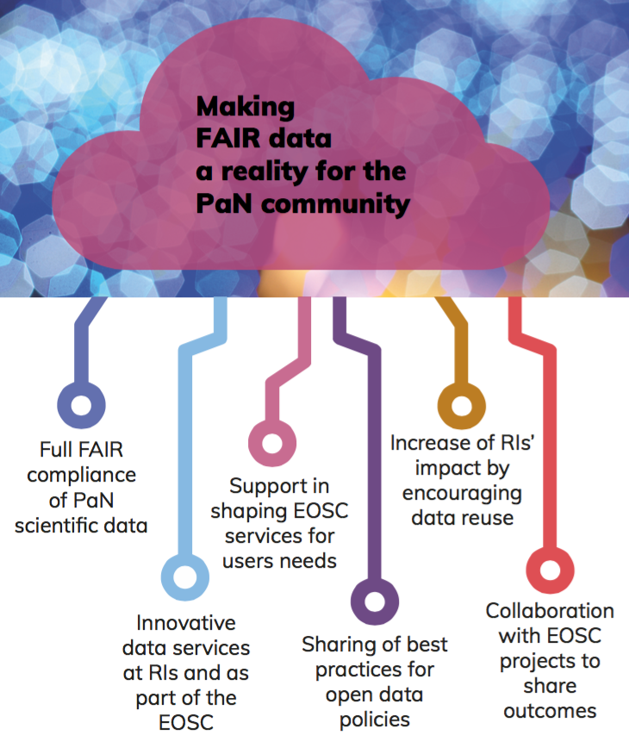
PaNOSC goals
PaNOSC works closely with the PaN sources in Europe to develop common policies, strategies and solutions in the area of FAIR data policy, data management and data services, integrating them into the EOSC.
This project has received funding from
the European Union’s Horizon 2020
research and innovation programme
under grant agreement No. 823852

Slide 4
Data management enables
On-site
data analysis
Publications
Data mining
AI
Open Data Analysed Data Digital Objects
Federated catalogues
On-site data reduction
Reduced Data Archived Data
Data + metadata catalogues
Raw Data
This project has received funding from the European Union’s Horizon 2020 research and innovation programme under grant agreement No. 823852

Slide 5
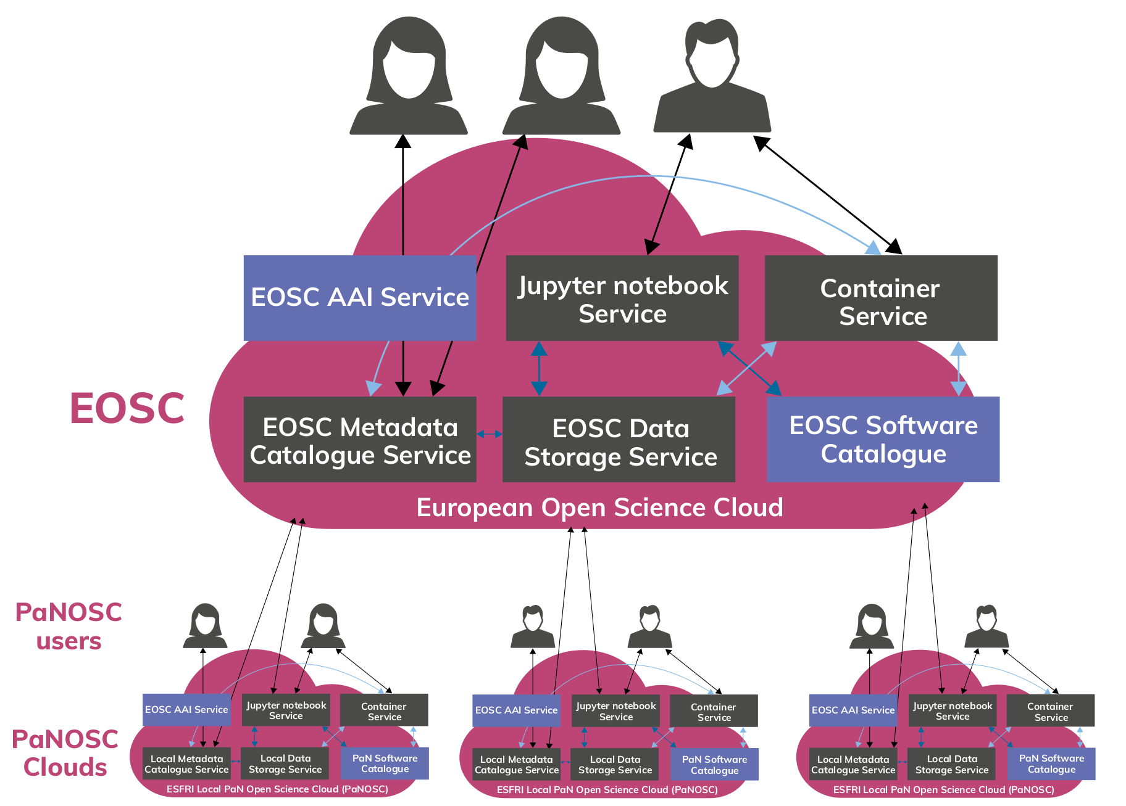

Our Vision – a PaN scientific commons
This project has received funding from the European Union’s Horizon 2020 research and innovation programme under grant agreement No. 823852

Slide 6


Goal: Update data policies to be
To make FAIR data a reality for research data produced by the photon and neutron facilities involved in PaNOSC and its sister project ExPaNDS, PaNOSC updated the PaNdata data policy framework to be FAIR [1]. The framework will be adopted by all partners to ensure they have FAIR data policies in place.
[1] PaNOSC FAIR research data
policy framework: https://doi.org/10.5281/zenodo.3862701
This project has received funding from the European Union’s Horizon 2020 research and innovation programme under grant agreement No. 823852

Slide 7


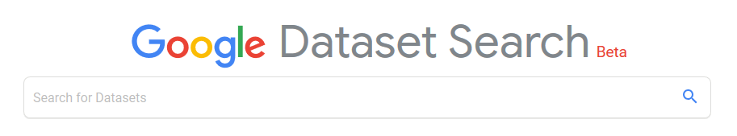
To make data Findable and Accessible, enabling domain-specific searches across the PaNOSC data repositories, a search API has been defined and developed.
Common API to search across all PaNOSC catalogues
ESRF
(icat)
CERIC
(icat)
ESS
(SciCat)
ILL
(local)
ELI
(tbd)
XFEL
(MyMdc)
This project has received funding from the European Union’s Horizon 2020 research and innovation programme under grant agreement No. 823852

Slide 8

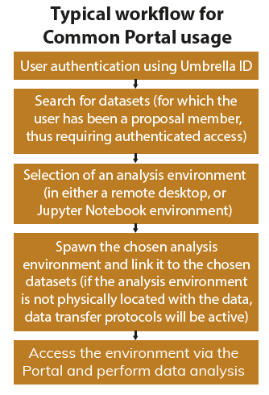
PaNOSC has been developing the PaN Portal for Data Analysis Services to enable to start a data analysis session as soon as a dataset has been collected. The Portal provides access to both remote desktop environments and Jupyter Notebooks, enabling users to remotely analyse data from PaN facilities during or after the experiment
After initial deployment at facilities to provide remote analysis services to local data, the Portal will be deployed as part of the EOSC to provide federated data analysis of data across the facilities.
This project has received funding from the European Union’s Horizon 2020 research and innovation programme under grant agreement No. 823852

Slide 9

PaNOSC has been developing the Virtual Neutron and x-raY Laboratory” (ViNYL).
ViNYL will:
Offer services for simulation and modelling of photon and neutron instruments, as well as start-to-end simulations to describe entire experiments at photon and neutron facilities
Make simulation data services inter-operable among the involved partners, such as OASYS, McSTAS and SIMEX
Enable RIs to seamlessly link this experiment simulation services to their in-house data reduction, analysis, and visualization infrastructures.
SIMEX is responsible for photon experiment simulations
This project has received funding from the European Union’s Horizon 2020 research and innovation programme under grant agreement No. 823852

Slide 10
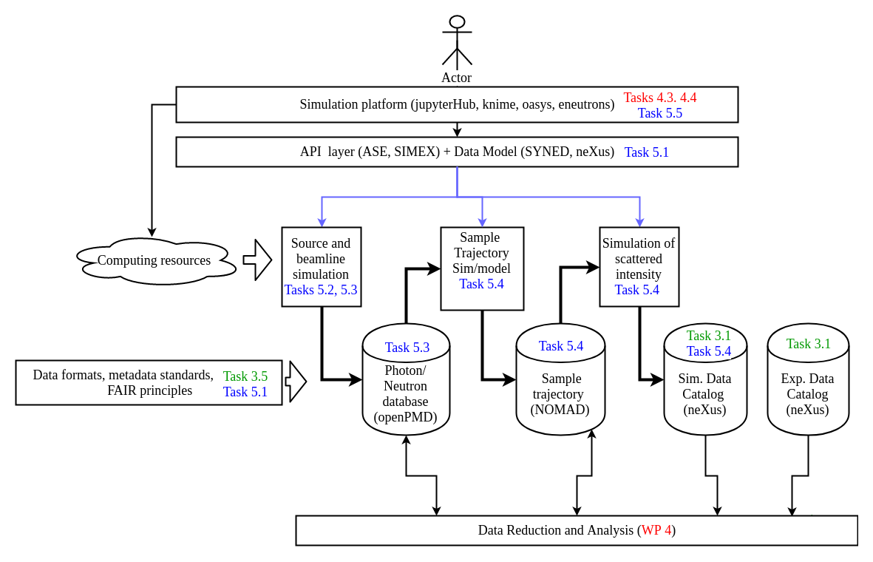
Simulation services
SIMEX: Start-to-end photon experiment simulation library (python)
McStas-script: python API for Neutron ray-tracing with McStas
OASYS: Wavefront propagation for beamline design (WISE)
EPOCH particle in cell + McStas: Simulation of laser driven neutron sources and ray tracing
This project has received funding from the European Union’s Horizon 2020 research and innovation programme under grant agreement No. 823852

Slide 11

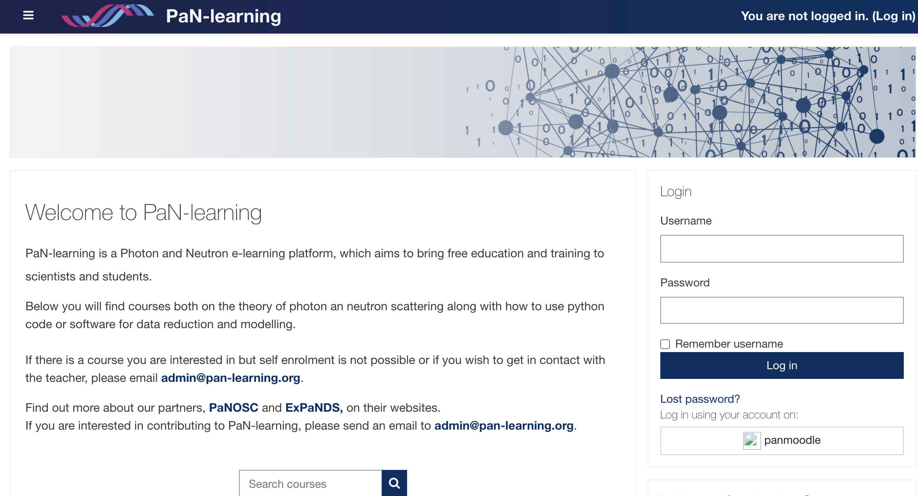
E-learning platform pan-learning.org
A virtual facility that enables students to perform virtual experiment simulations
This project has received funding from the European Union’s Horizon 2020 research and innovation programme under grant agreement No. 823852

